Slide 1

Exclusive Case Studies on Supply Chain Management Case Study: Demand Planning 15-Feb-2026

Slide 2
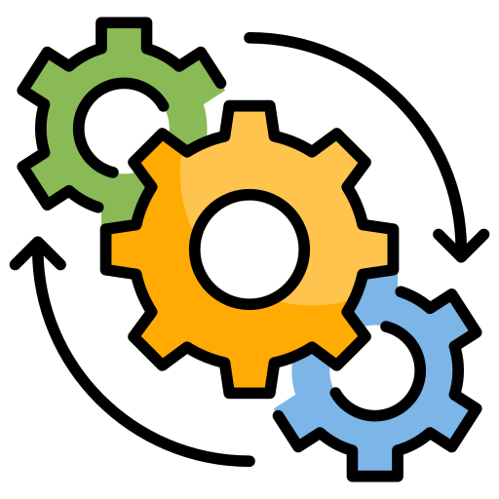







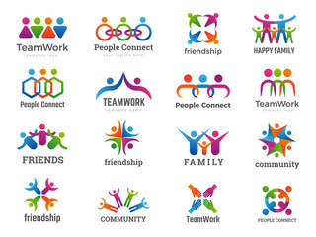
About SCM Connect Private Limited
Optimizing Supply Chains
7+ years in Operations
Our vision is to revolutionize Supply Chain Management by providing innovative solutions that focus on
Expertise in Supply chain Strategy and Planning, Supply chain-as-a-service, Data analytics & AI, Technology and Supply chain education
Cost Effectiveness
Clients across industry segments Manufacturing, Retail, e-Commerce, Consulting and Logistics
Well networked with partner ecosystem comprising of Technology, Logistics and Academic players
Enhance Efficiency
Multiple offices across India
Improve Visibility
20+ Professionals; Expertise in Supply Chain domain, Operations, Data Analytics and Technology

Slide 3





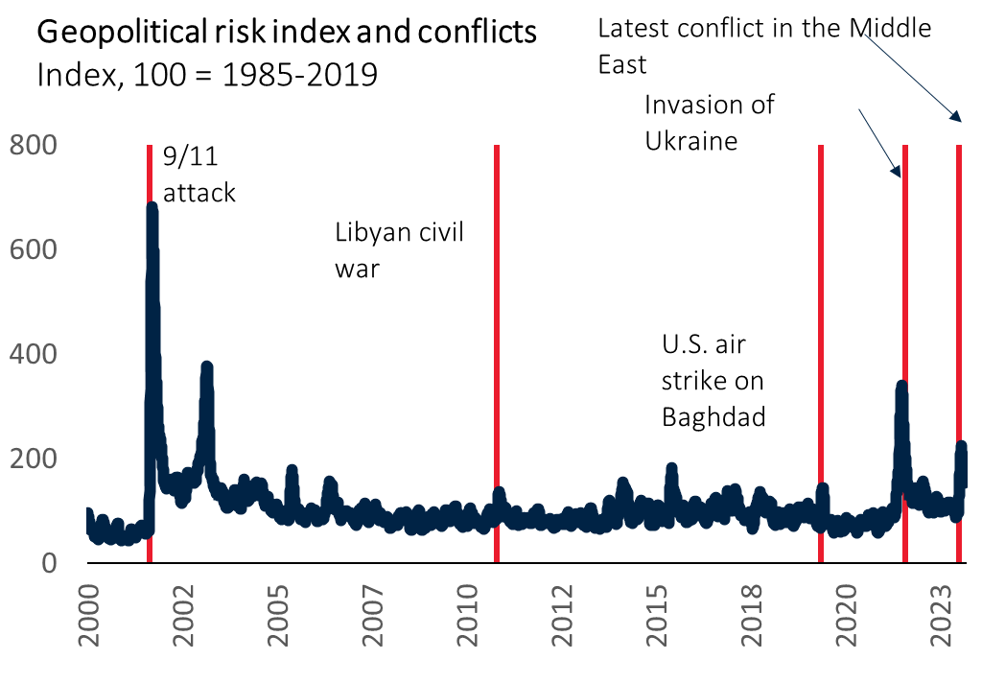
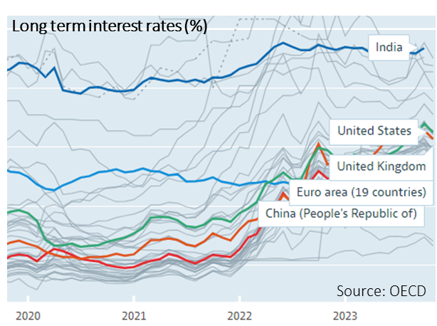
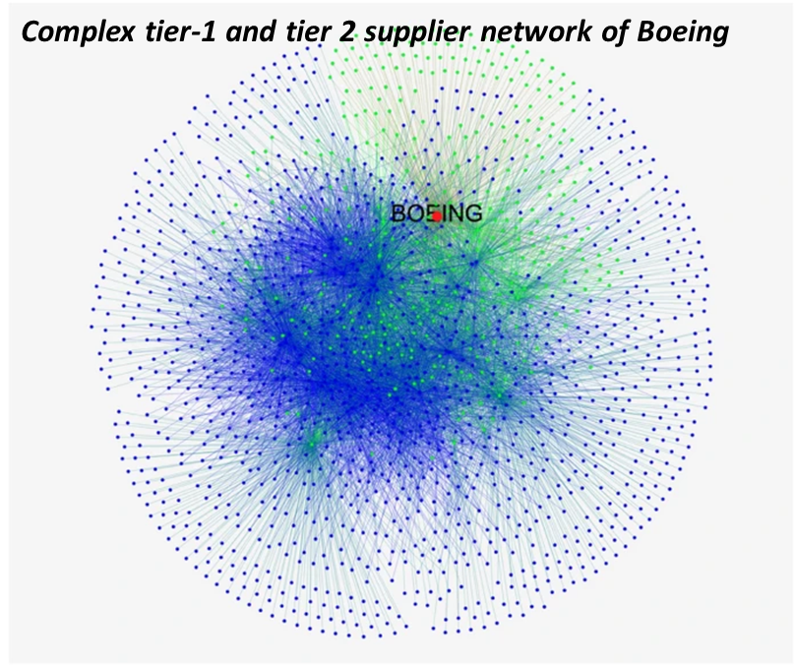
Increasing economic and political uncertainties and changing expectations of stakeholders…
1
2
3
4
5
Business shocks
Economic uncertainties
Global operating complexity
Changing customer expectations
Sustainability
More frequent business shocks due to interplay of climate change, pandemics, geo-political tensions.
Recent conflicts in easter Europe and the Middle East has disrupted global supply chains significantly
Economic uncertainties continues. Post pandemic recovery in global growth and falling inflation rates is surprisingly resilient
However, high interest rates will continue to weigh heavily on growth momentum
Evolving ‘China + many’ strategy offers significant opportunity
However, labor and logistics capacity constraints coupled with need for omni-channel presence and evolving ecosystem of players are increasing the complexity of supply chain
Customers expectations in terms of quality, timeliness and sustainability are evolving faster than expected
This is likely to put innovation and collaboration high on agenda within supply chain management
According to a Verint report, 44% of Gen Z and 43% of Millennial shoppers had to make more effort than expected to complete an interaction. This indicates that new generations have even higher expectations for their digital experiences
Rising expectations from regulators, customers and investors to minimize the environmental impact
High focus on sustainable supply chains in pursuit of “net zero”
>90% of publicly traded companies have adopted ESG reporting
According to Statista, consumers are 44% more likely to buy from a brand with a clear commitment to sustainability
Tier 1 Suppliers
Tier 2 Suppliers
Journal of International Business Studies

Slide 4





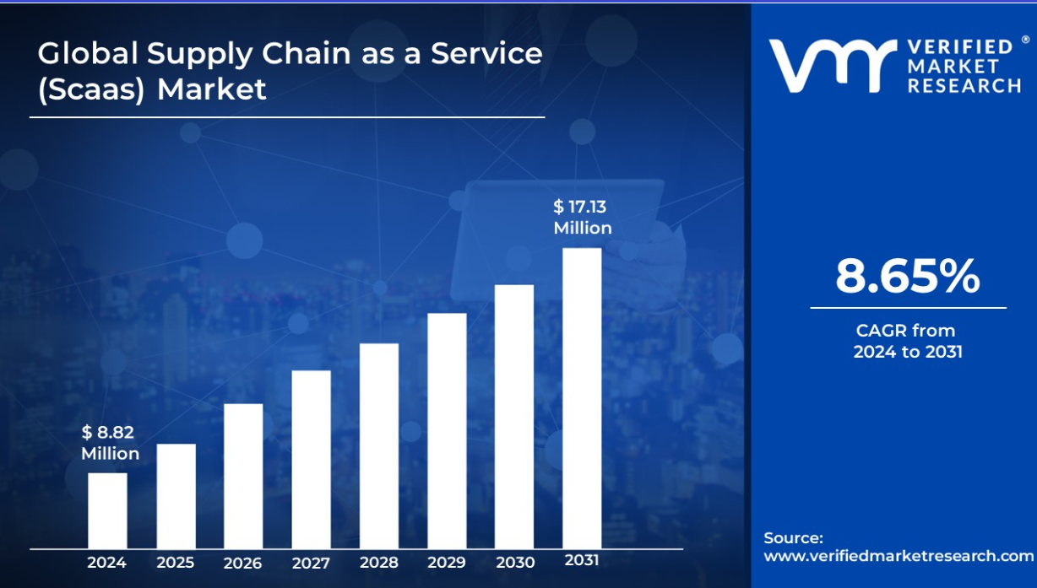
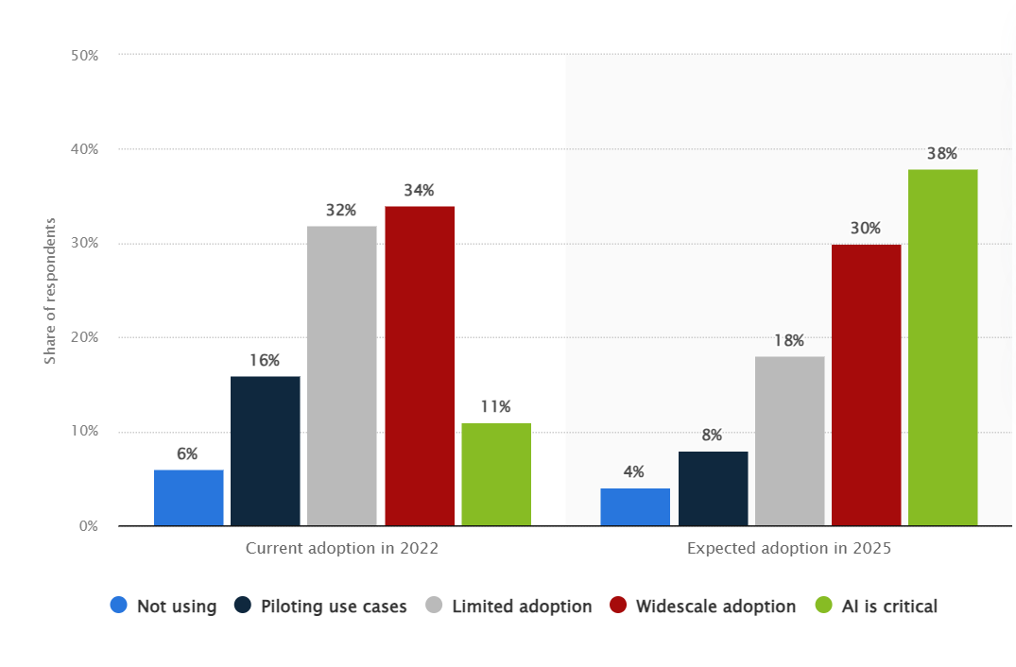
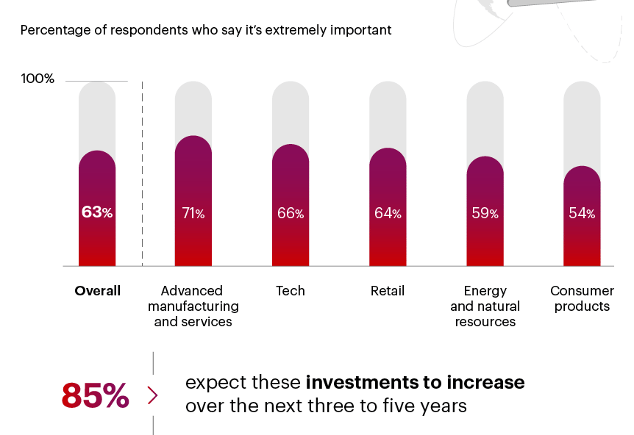
… are mounting pressure on supply chains to innovate and become more efficient.
1
2
3
4
5
Supply Chain As A Service
Data Analytics and AI
Digitalization
Circular Supply Chain
Risk Management
Need for agility, best practice adoption, end-to-end visibility, cost savings and resiliency is driving faster adoption of SCaaS
The global SCaaS market is expected to grow at 8.65% CAGR between 2024 and 2031
Future supply chains will be data and AI driven Analytics will reduce cost, increase visibility and improve customer experiences. AI is likely to augment quality, bring agility and automation of supply chains globally
Digital transformation of supply chain has become top priority to support new business, improve efficiency and productivity, enhance decision making and improve resiliency/agility amid ongoing supply chain disruption
A study by the Council of Supply Chain Management Professionals (CSCMP) has found that more companies than ever (93%) are actively engaged in digital transformation for a significant competitive advantage
Circular supply chain is likely to be a major trend driven by sustainability goals of reducing carbon emissions across the supply chain coupled with need to mitigate inflation risks, reduce wastage and respond to the return logistics requirements
A recent Gartner survey found that 74% of supply chain leaders expect profits to grow over the next two years as a result of applying circular economy principles
Being resilient and mitigating the risk is critical in an environment of economic uncertainties, increasing frequency of globally disruptive events, growing operational complexity, and rising instances of cybersecurity breaches and loss of IPs
Artificial intelligence (AI) adoption rate in supply chain in 2022 and 2025
Supply Chain Resiliency is important
Global Supply Chain as a Service Market size
Source: Verifiedmarketresearch.com
Source: Statista

Slide 5

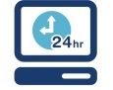
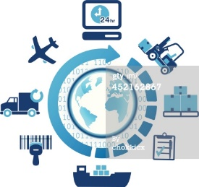
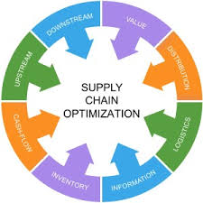

Service offerings
Strategy | Service | Data & AI | Technology | Training
Supply Chain Strategy & Planning
Supply Chain-as-a-Service
Data Analytics
& AI
Supply Chain
Technology
Supply Chain Training & Development
Supply Chain Strategy
Network Strategy & optimization
Inventory optimization
Procurement strategy
Supply Chain Risk Management
Opportunity assessment
Sustainability & ESG
Research & Intelligence
Demand Planning and Management
Sales & Operations Planning & Management
Inventory Planning & Management
Production Planning & Scheduling
Procurement Planning & Management
Supply Chain Data Strategy
Supply Chain Diagnostics
Supply Chain Analytics (AI, machine learning and advanced analytics)
Procurement Analytics
Supply Chain master data management
Data Governance
Visualization
AI adoption
Digital Supply Chain
Supply Chain Simulations
Supply Chain Apps and APIs
Supply Chain Visibility through RFID, QR codes and bar codes
Telematics
Solver Integrations for Optimization
Supply Chain Master Class
Bespoke learning programs
Utilizing modern methods including Gamification and Case Study based
Change Management
We extensively leverage the partner ecosystem to augment our capabilities in the areas of Technology and Operations

Slide 6
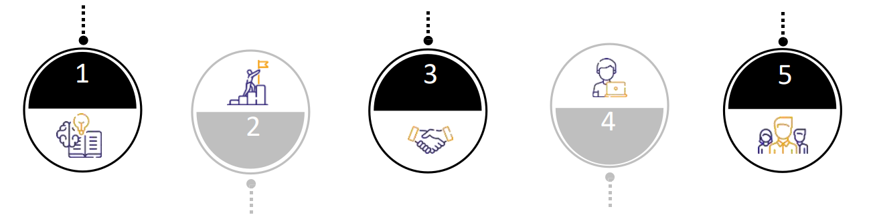

Why SCM Connect?
Flexible ways of working suiting specific requirements
Domain expertise
Extensive experience and know-how of managing and improving solutions through converged supply chain operations, data, technology and business expertise
High performing team
Skilled pool of resources, across supply chain domain; Matured processes to ensure talent management and development, and operations resilience
Delighted clients base
High concentration of repeat engagements (~90% ) ; highly satisfied clients with high Net Promoter Score
1
3
5
2
4
Commitment to success
Commitment and focus with the goal of “Work as One” team, having “courage”, “technical excellence” and “customer focused” as DNA
Best suited engagement models
Flexible engagement models as per client’s need with focus on outcome & continuous quality monitoring

Slide 7
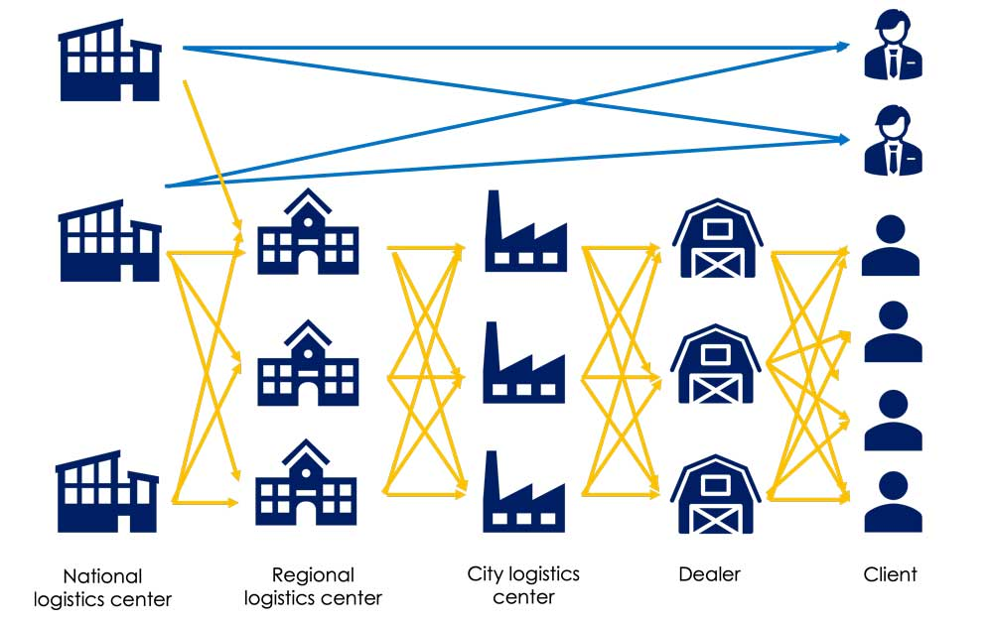
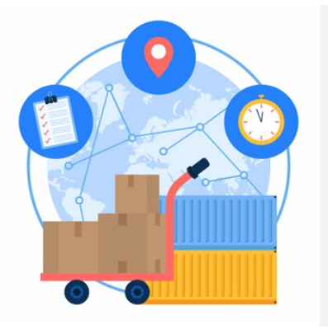
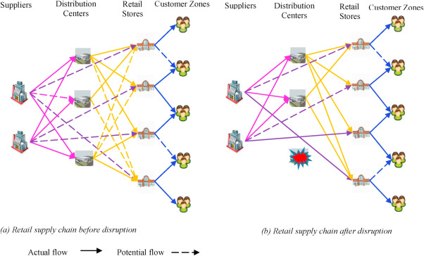
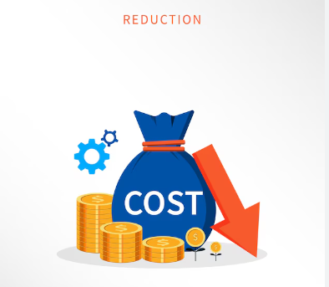
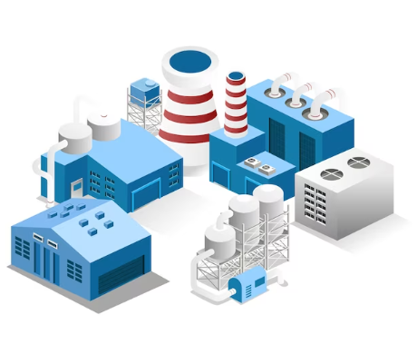
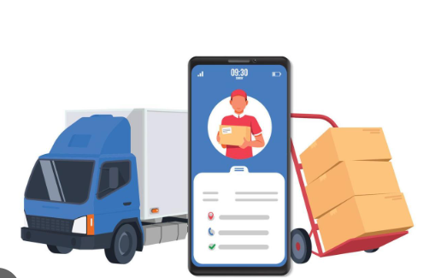
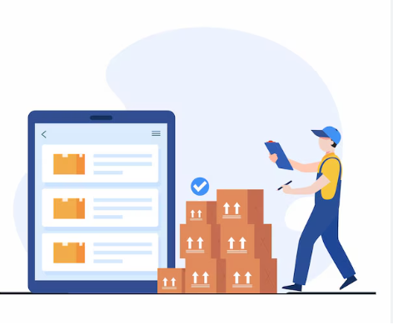
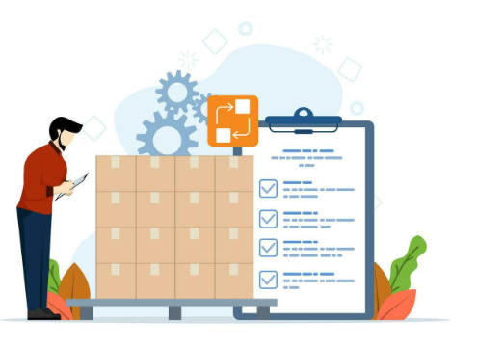
Case Studies
Cost Optimization | Efficiency Enhancement | Visibility Improvement
SUPPLY CHAIN NETWORK DESIGN INDUSTRY – Refrigerant Gas
SUPPLY CHAIN VISIBILITY INDUSTRY – FMCG
APPROACH : Supply Chain Network designed for next 5 years including OEMs and Trade, as per targtted SLAs
OEM 90% within 36 hrs and Trade 80% within 48 hrs
APPROACH : Implemented supply chain visibility solution for a French electrical MNC, integrating plant-to-customer tracking for two product lines and linking with loyalty program app.
RESULT : Cost Reduction of 16.71%
RESULT : 100% visibility of all SKUs on a single platform
SUPPLY CHAIN NETWORK DESIGN INDUSTRY – Animal Nutrition
LOGISTICS COST REDUCTION INDUSTRY – HVAC
APPROACH : Re-Design Supply Chain in view of GST to achieve Service Level efficiency of 90% + within 96hrs of Customer order.
APPROACH : Optimized outbound logistics costs while maintaining service levels through RFQ design, vendor selection, and contract standardization
RESULT : Cost Reduction of 8.25%
RESULT : Savings in freight cost by 31%
FACILITY LOCATION INDUSTRY – Industrial Gas
FREIGHT OPTIMIZATION INDUSTRY – Chemicals
APPROACH : Determine the ideal location of RG filling station to cater to Trade Distributors. Customers based in North and East India
APPROACH : Optimized outbound logistics costs for CMS, including tanker and drum movement through product flow optimization and service provider contract standardization
RESULT : Wt. Average distance reduction = 39% and
Cost reduction of 3.6%.
RESULTS : Cost reduction of 4.94%
INVENTORY STRATEGY and S&OP INDUSTRY – Tyre Retreading
INVENTORY MANAGEMENT & PROCUREMENT SERVICE INDUSTRY – Home Appliances
APPROACH : Designed inventory strategy for finished goods across depots, setting SKU-specific policies, and executing monthly S&OP for demand-production-procurement alignment
APPROACH : Designed RM hierarchy, FG BOMs, and inventory policies. Spend Analysis, RFQ/Sourcing, Contract Management, and Supplier Performance Dashboard
RESULTS : Annualized Savings of INR 50mn
RESULT : Reduction in DIO by 23%

Slide 8

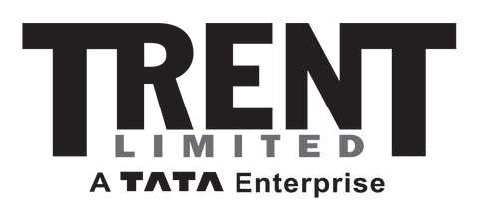

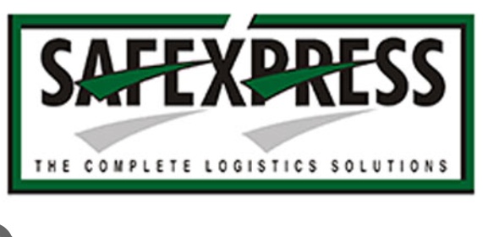
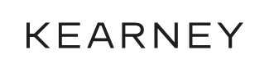







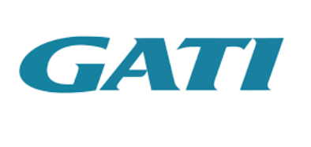





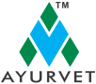

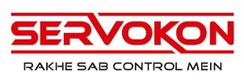

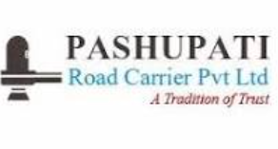


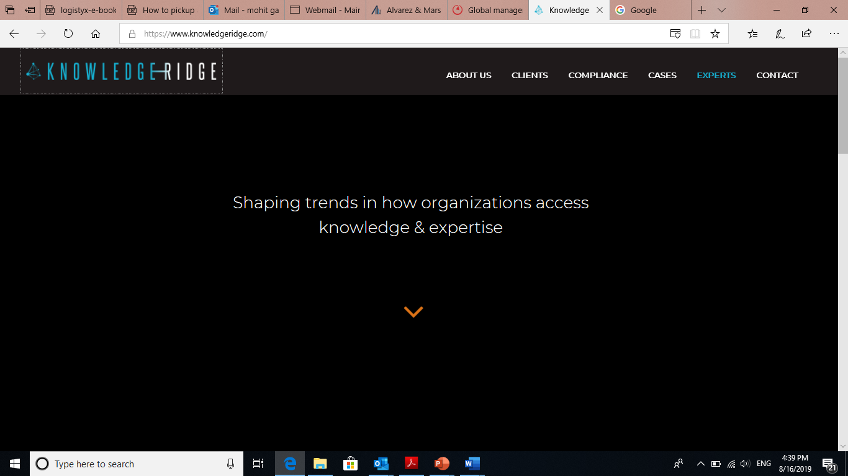
Key client segments
Creating incisive impact across client segments
Manufacturing/Retail
Consulting
Logistics / 3PL

Slide 9
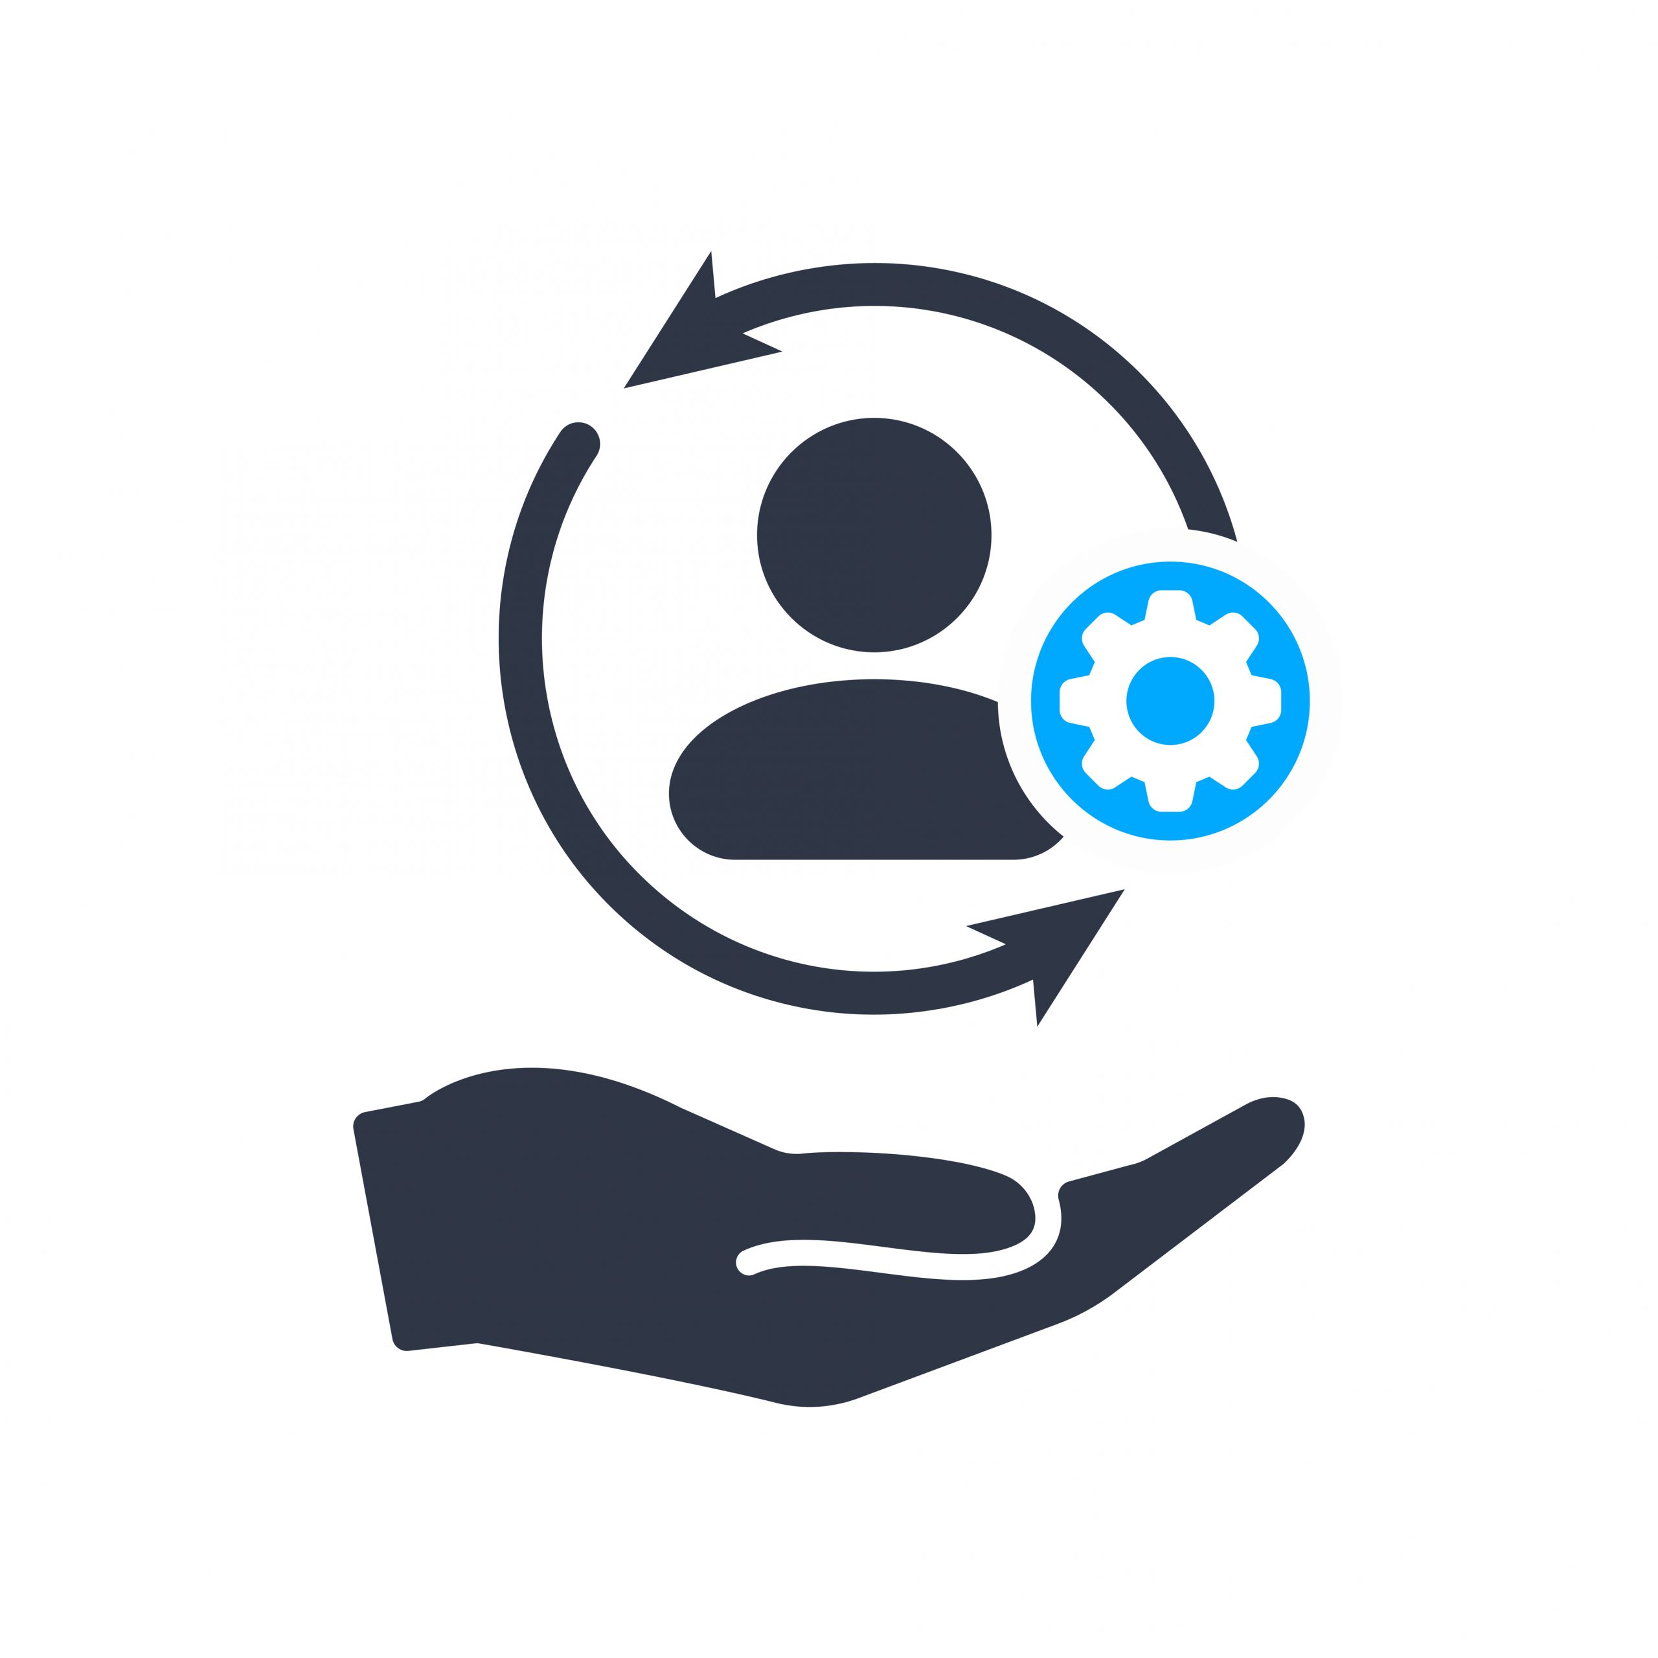
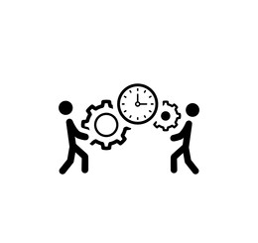


Engagement models
Flexible ways of working suiting specific requirements
Managed services
Project / Outcome based
Embedded team
Subscription based
Execution through proactively defining, monitoring, managing & improving processes
Control through outcomes, SLAs, KPIs
Full ownership for delivery and ability to influence the process
Cost of service is pre-agreed/fixed
Drive efficiency through CI, automation
One time ad hoc / intermittent activities requiring “on tap” support
Short duration of services (2-12 weeks)
Deployment of converged capabilities – technology, data, domain and business
Augment skills not available in house while maintaining responsibility for overall project/program management
Ongoing process requiring business knowledge
Basket of work requiring similar skills
Fully integrated with client’s team
Access to underlying product / solution
Pricing through no. of licenses, volume of usage and/or period of time
Benefits
Outcome-based engagement
Fill skill gaps while running processes efficiently
Continuous improvement
Flexibility
Less supervision required
Benefits
Flexibility
Resource mix will ensure that multiple project requirements are met
Provides mitigation for resource attrition
Benefits
Dedicated resources for the activity
Provisioning of lacking skills
Business knowledge is retained
Cost arbitrage
Better perceived control
Benefits
Better predictability
Lower cost for a committed engagement
We offer various pricing models which are fit-for-purpose for clients’ need:
Time & Material | Fixed fee | Transaction based | License based | Outcome based (Gain / Value share)

Slide 10
Why offshore supply chain activities to India?
Lower operating cost | Established model | Business resilience | Digital and data | Talent pool | Continuous improvement
1
2
3
Lower operating cost
Upto ~87% cost savings on resources (source: Everest Consulting, 2023)
Shift from fixed operating cost and capital cost to variable operating cost
Established offshore delivery model
Globalization, technology advancement enabling remote working, and increasing need of cost reduction are key drivers
~2.4mn FTEs are employed by offshore business services of global companies, in addition to a substantially higher number outsourced to third parties
India continues as the most popular offshore services destination accounting for ~50% of the deployed headcount
Business resilience
Flexibility in ramping up and down
Strategic alliances with fewer but reliable outsourcing providers can guarantee ongoing operations at times of disruption
Extending working hours of the organization through addition of time zones
4
5
6
Deep data and technology skills
The supply chains across the world are witnessing a digital shake-up. To ride this transformation companies need resources which are data and digital native
With its well matured ITeS ecosystem, India is well positioned to fulfill such need
Large experienced talent pool
Convergence of operational, supply chain domain and data & technology expertise requires multi-skilled employees
With its burgeoning domestic sector, India has access to abundant pool of experienced supply chain resources
Continuous improvement and innovation
The evolving operating model has established a process of continuous improvement and innovation in the offshored activities
These are also driven by underlying contractual obligations

Slide 11
Supply Chain Playbook

Slide 12
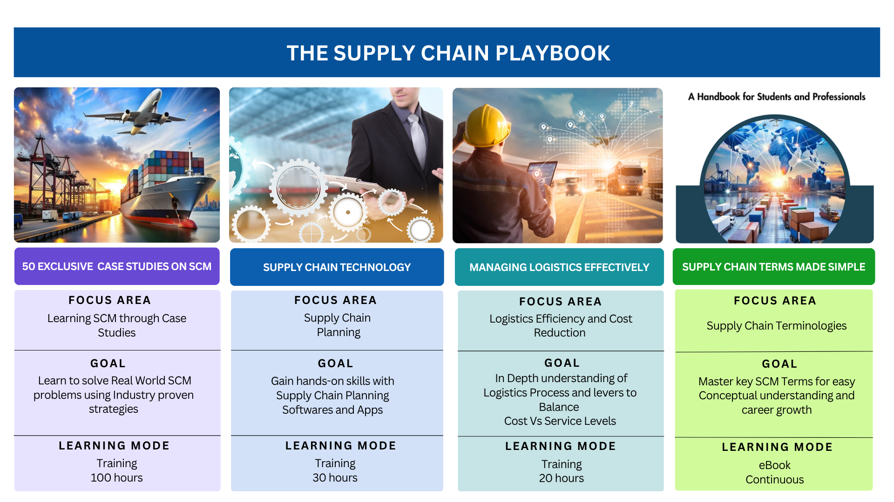

Slide 13
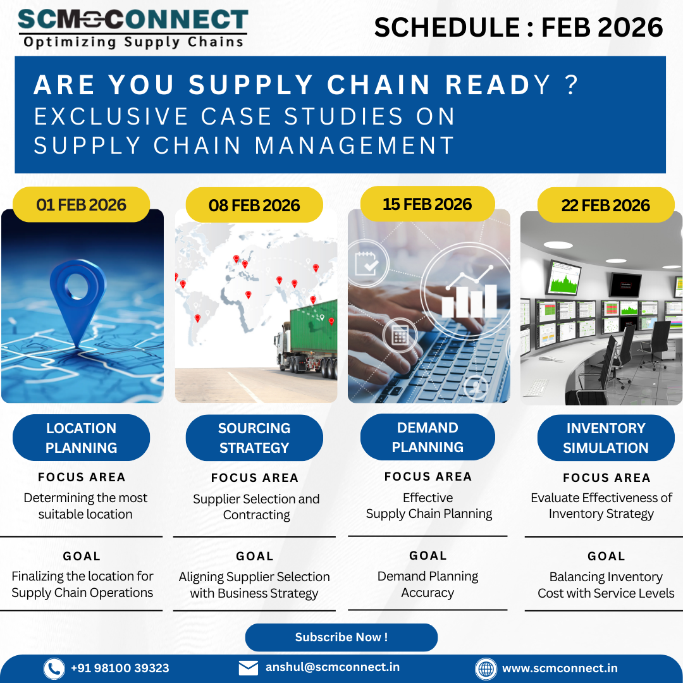
50 Exclusive Case Studies on
Supply Chain Management
What will you learn?
Structuring a Supply Chain Problem
Location Planning to determine the most suitable location for the facility
Supplier Selection and Contracting
Demand Planning as a key component of Effective Supply Chain Planning
Evaluating the Effectiveness of Inventory Strategy
Interpreting Results
Scenario based Simulations

Slide 14
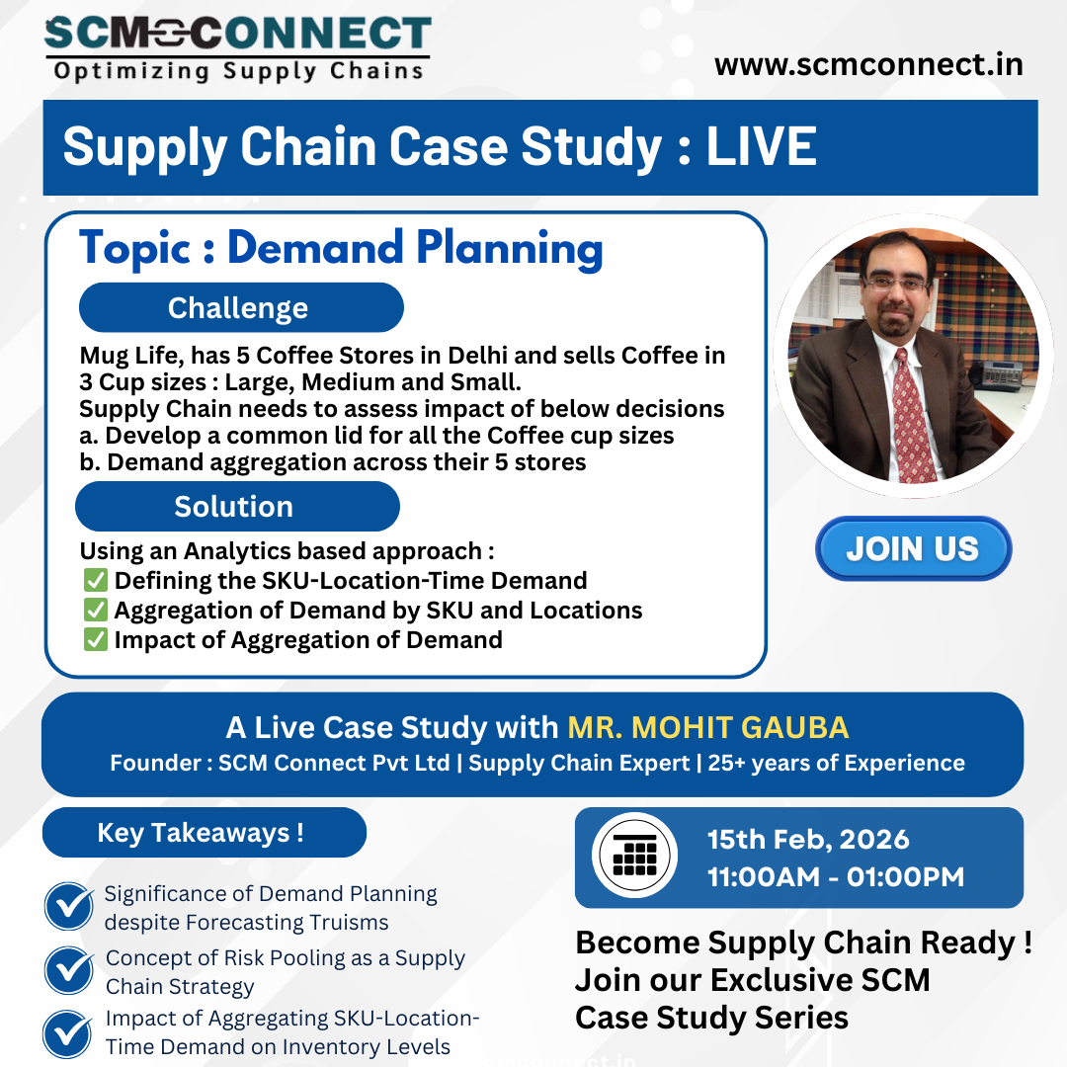
Case Study : Demand Planning
15-Feb-2026
What will you learn?
Defining the Demand : SKU-Location-Time based Demand
Data Requirements & Structuring the Data
Significance of Demand Planning
Demand Patterns - Concept of Variability
Forecasting Truisms
Concept of Risk Pooling as a Supply Chain Strategy
Impact of Aggregation on Inventory Levels
Scenario based Simulations

Slide 15
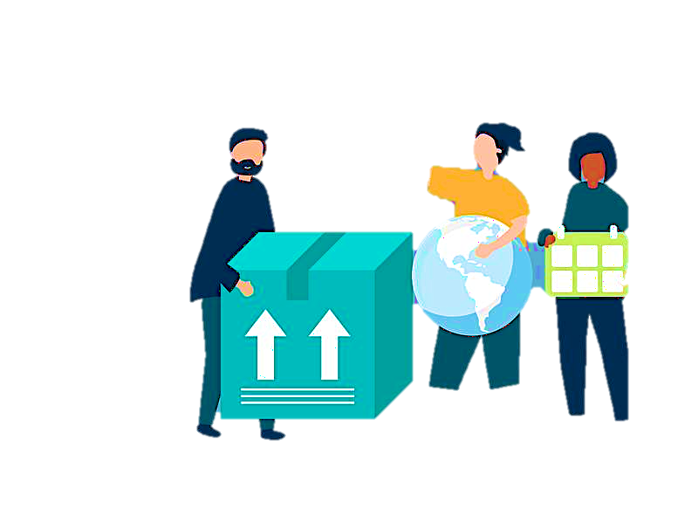
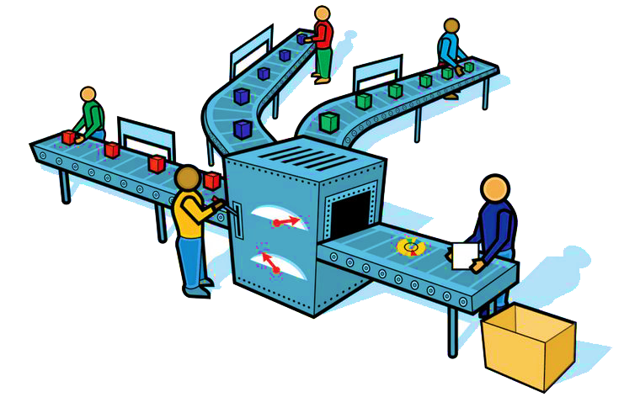

Supply Chain Management-Scope
Manage Upstream & Downstream Supply Chains
Procure to Pay & Order to Cash
Ensure visibility between Supplier Tier 2 and Customer Tier 2
Management, Visibility and Planning interactions between Manufacturer and Suppliers ( Procure to Pay Cycle) as well as Manufacturer to Customers (Order to Cash Cycle)
PLANNING
Upstream Supply Chain
Downstream Supply Chain
S2
S1
M 1
C1
C2
TIER 2
TIER 1
TIER 1
TIER 2
SUPPLIER
CUSTOMER
EXECUTION

Slide 16
Procure to Pay and Order to Cash
Procure to pay process of integrating purchasing and accounts payable systems to create greater efficiencies. It exists within the larger procurement management process and involves four key stages: Selecting goods and services, Enforcing compliance and order, Receiving and reconciliation, Invoicing and payment.
OTC encompasses the entire lifecycle of order fulfillment. The order-to-cash process includes all actions required to process customer orders and deliver the products and services to fulfill those orders. It involves numerous business functions such as inventory management, operations, and production.
S2
S1
M 1
C1
C2
TIER 2
TIER 1
TIER 1
TIER 2
SUPPLIER
CUSTOMER
PROCURE TO PAY
ORDER TO CASH

Slide 17
Why Demand Planning Matters?
India has one of the highest supply chain costs in the world
India has one of the lowest logistics cost in INR/Kg in the world
Potential reduction of inventory cost by up to $100-150bn in India
Reducing the costs while improving service levels is essential for Make in India
Concept of VALUE DENSITY

Slide 18
Key Concepts : Demand Process
Demand Planning
What should we do to shape and create the Demand?
Product| Pricing| Promotion | Place
Demand Forecasting
What should we expect Demand to be?
Strategic | Tactical | Operational
Demand Management
How do we prepare and act when Demand materializes?
Balance Demand and Supply
Considers External and Internal factors
Sales & Operations Planning

Slide 19
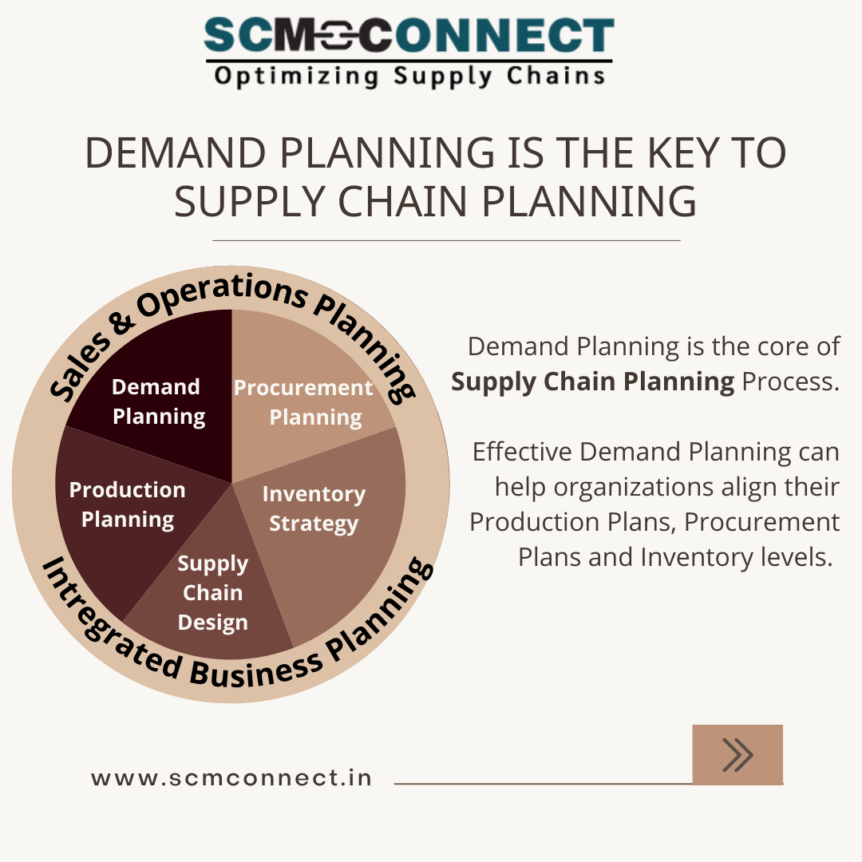
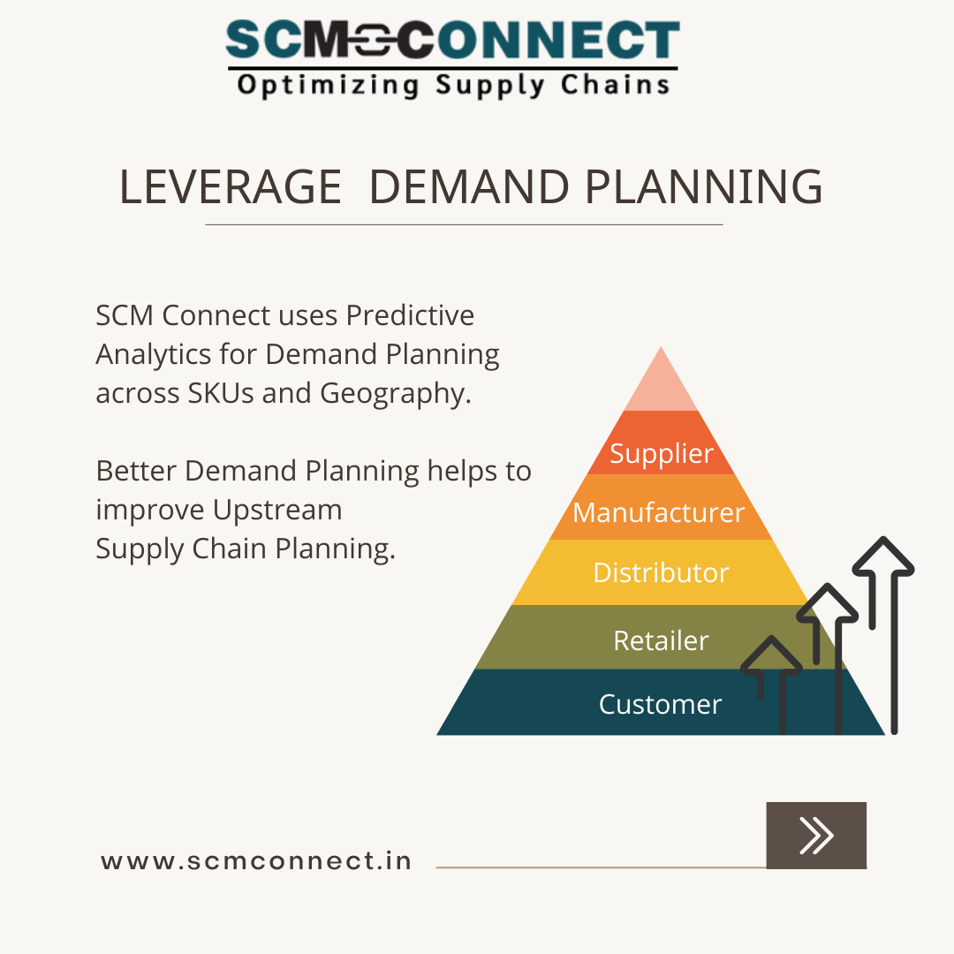
Key Concepts : Demand Planning

Slide 20
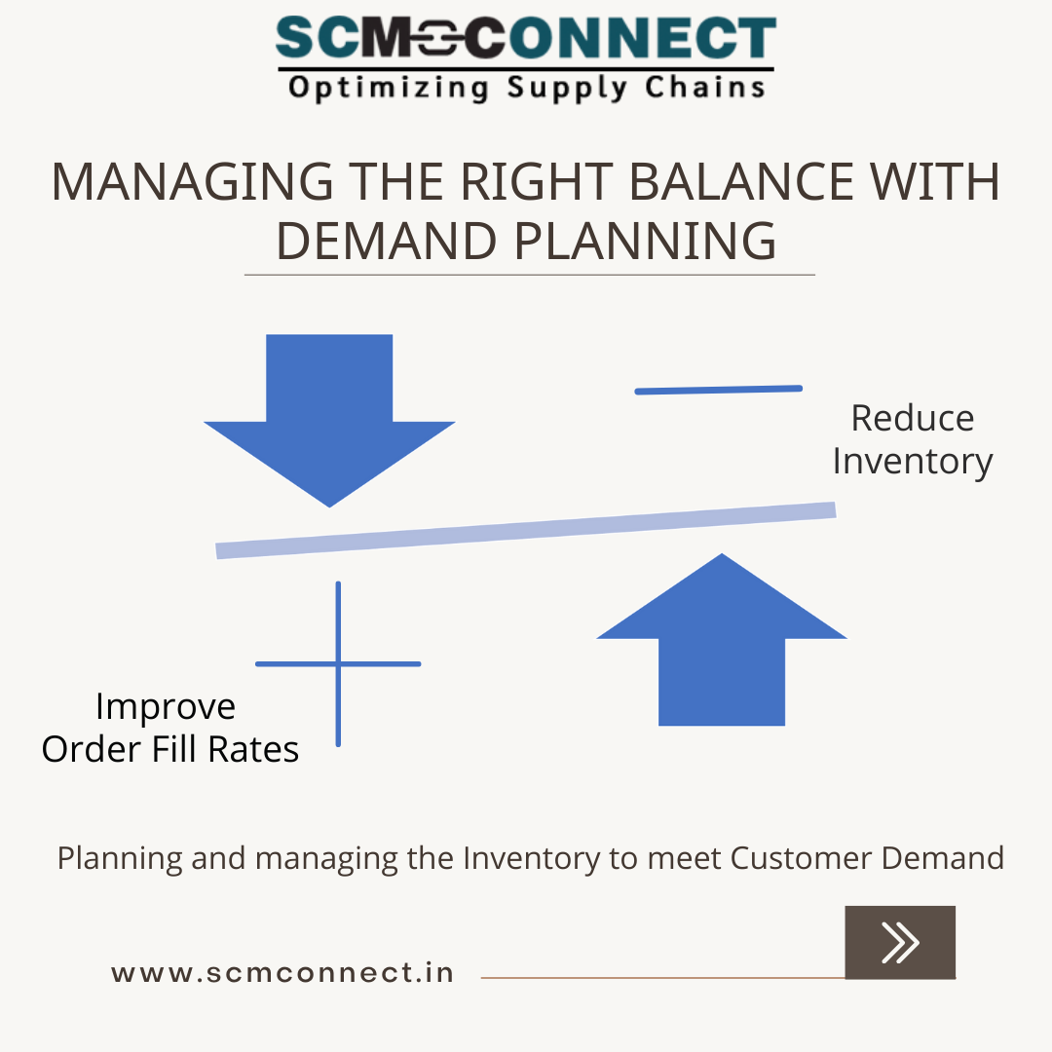
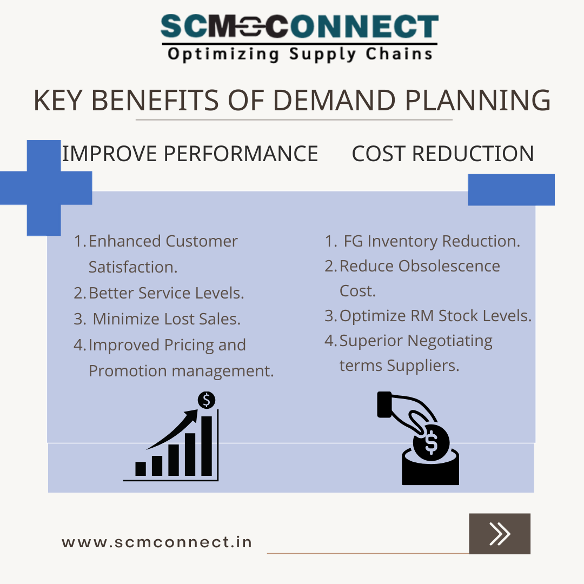
Key Concepts : Demand Planning

Slide 21
Key Concepts : Demand Forecasting
Level | Horizon | Purposes
Strategic | Year(s) | Business Planning Capacity Planning Investments
Tactical | Months Quarterly | Master Planning Inventory Planning Sales Planning Budgeting
Operational | Days | Production Planning Transportation Planning Inventory Deployment

Slide 22
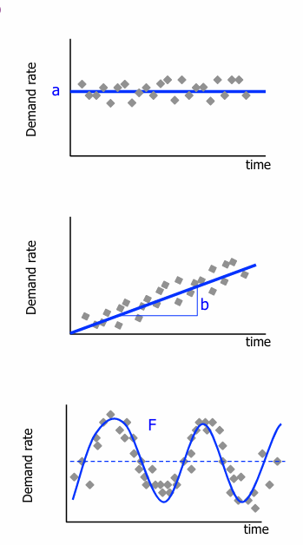
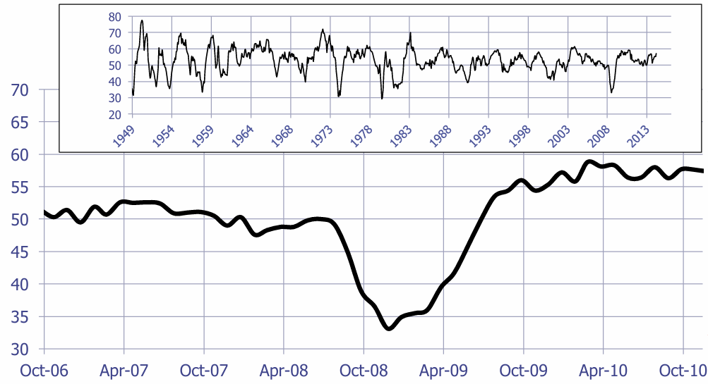
Key Concepts : Demand Patterns
Level (a)
- Demand hovers around mean
Trend (b)
Persistent movement in one direction
Rate of Growth or Decline
Seasonal Variations (F)
- Repeated cycle after a known or Fixed period
Cyclical (C)
- Periodic movement not of fixed period
Random Fluctuations (e)
- Remainder of variability

Slide 23
Key Concepts : Forecasting Models
Demand Pattern | Model | Techniques
Level | x (t) = a + e | Naïve (Only last period matters) Cumulative (Everything Matters) Moving Average (Select how much matters) Exponential Smoothing ( Weight decreases exponentially as they age)
Level - Trend | x (t) = a + bt + e | Holt Model Damped Trends
Level - Seasonality | x (t) = a F(t) + e | Double Exponential Smoothing
Level- Trend- Seasonality | x (t) = (a+bt) F(t) + e | Holt-Winter Model

Slide 24
Key Concepts : Forecasting Truisms
Forecasts are always Wrong
Use Range forecasts
Aggregate Forecasts are more Accurate
Risk pooling reduces Variability (CV)
Shorter Horizon Forecasts are more Accurate
Postpone customization until as late as possible

Slide 25
Key Concepts : Risk Pooling
Risk pooling means
Reducing uncertainty (variability)
By aggregating demand or inventory across products, locations, customers, or time periods
Why Risk Pooling Matters?
Individual demands fluctuate randomly
When pooled, high demand in one area offsets low demand in another
Result: lower safety stock, lower costs, better service levels
Benefits of Risk Pooling
Reduces Safety Stock
Lower Inventory
Improved Forecast accuracy
Higher Service Levels
Better Capacity Utilization
Use Cases of Risk Pooling
Location Pooling
Many regional warehouses → one central warehouse
Total safety stock required decreases
Product Pooling
Separate SKUs → postponement/common components
Example: Same base product, customized later
Time Pooling
Weekly demand planning instead of daily
Reduces short-term variability
Demand Pooling
Forecast demand at aggregate level instead of SKU/location level
Pooled variability < sum of individual variabilities

Slide 26
Key Concepts : Demand Aggregation
Aggregation Type | Impact
Aggregation by SKU | Reduces Variability Increases Forecasting Accuracy Lowers Safety Stock Requirements Example of Parts Commonality
Aggregation by Location | Reduces Variability Reduces Inventory Improves Service Levels Risk Pooling improves Forecast accuracy E.g. Consolidation of Depots post GST implementation
Aggregation by Time | The Time bucket used should match the situation Lower variability for longer time buckets and hence better forecast accuracy

Slide 27
Train to Gain
Exclusive Case Studies on Supply Chain Management

Slide 28
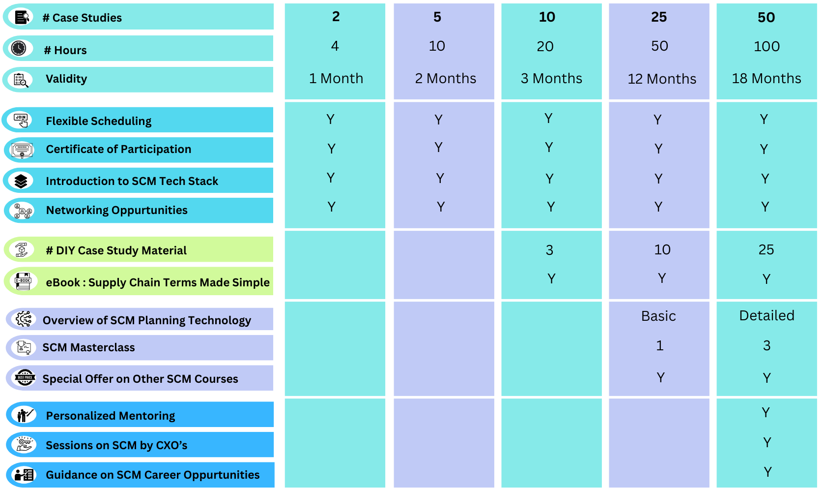
Exclusive Case Studies on Supply Chain Management

Slide 29
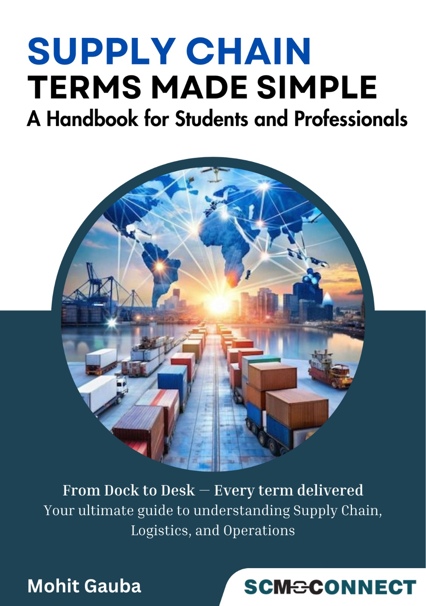
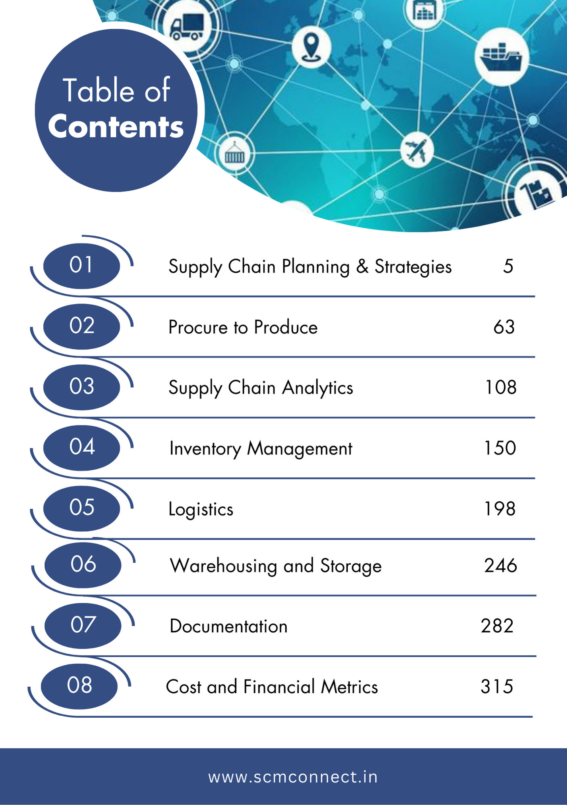
Supply Chain Terms Made Simple : eBook
23-May-2025

Slide 30
Welcome to Supply Chain Community ! Mohit Gauba Email : mohit.gauba@scmconnect.in Mobile : +91 98186 97696

